Slide 1
Big Ski Resort Price Modeling
06/29/2021

Slide 2
Outline
Objective: To leverage current facilities and strategically plan future investments.
How: Model ticket price based on the features from data collected and perform various scenarios of closing down or opening facilities to calculate the revenue generated from each scenario and make a sound data driven business decision.
Key steps in Data Science Method:
Problem Identification:
Data Wrangling:
Exploratory Data Analysis
Pre-processing and Training Data Development
Modeling

Slide 3
Problem Identification
Context: Big Mountain Resort recently installed an additional chair lift for $1540000. Can we justify increasing ticket price in order to cover for the investments?
Success criterion: We will be successful if we can increase ticket price such that we atleast break-even the investment as soon as possible before the end of the season.
Scope: Build a model with the features available and predict the price of our resort.
Constraints: Price cannot be too high for example more than 25% of current price.
Data Source: csv file which contains information about various key resorts in the US.

Slide 4
Recommendation and key findings
5 run closures, increasing vertical drop and installing additional chair lift
This would drive-up the revenues by $15000000 where as the investment was only $1500000 (10 times less)
Other scenarios of adding 2 acres of snow making cover and increasing the longest run by 0.2 miles didn’t yield significant revenues

Slide 5
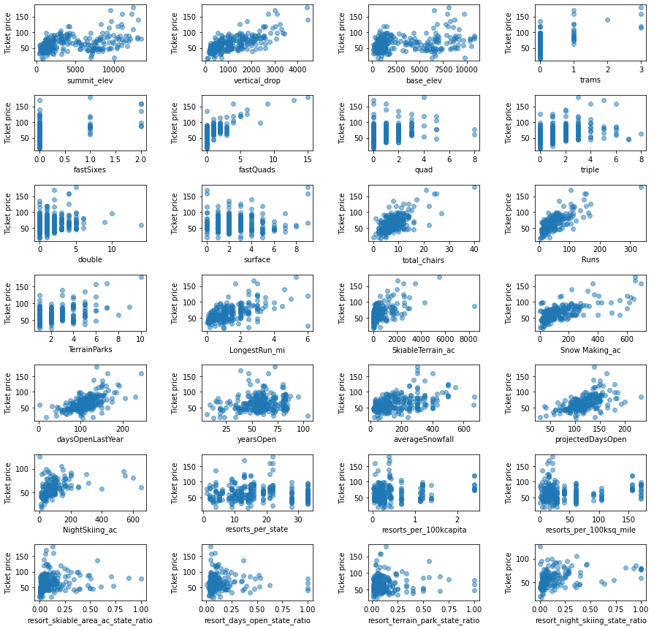
Modeling results and analysis
Scatter plots of various features
Important features: 1. Vertical_drop
2. Snow Making_ac
3. total_chairs
4. fastQuads
5. Runs
6. LongestRun_mi
7. trams
8. SkiableTerrain_ac

Slide 6
Modeling results and analysis
Final pipeline chosen:
Imputer function: Median
Scaler function: None
Random Forest Regressor with n estimators = 69
Results:
Mean Absolute Error: $10.39
Standard Deviation: $1.47
Predicted ticket price: $95.87
Actual ticket price: $81 (more than one MAE off- quite big discrepancy)

Slide 7
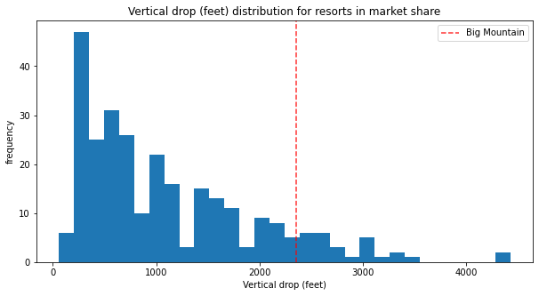
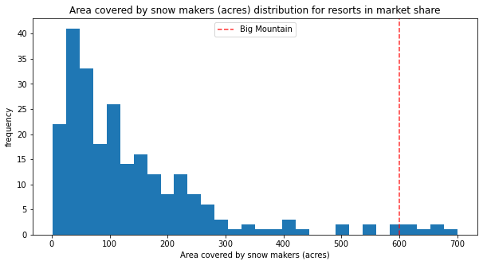
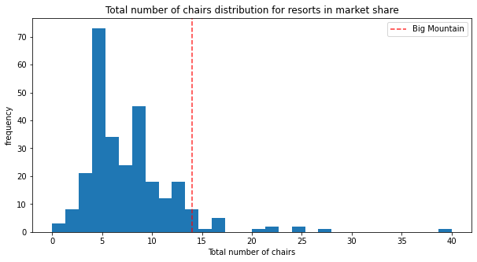
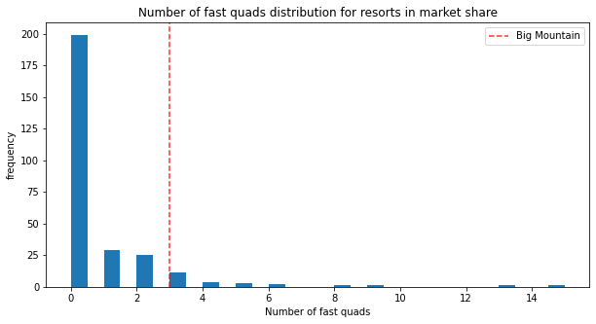
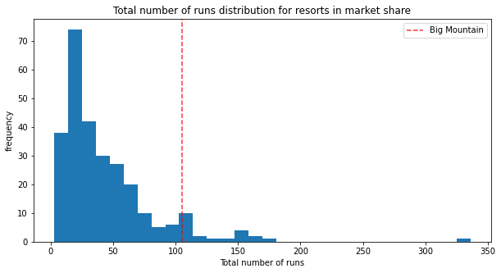
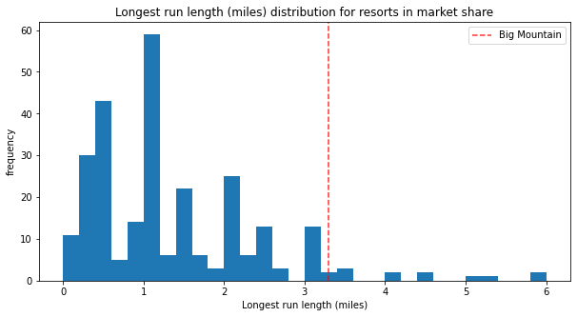
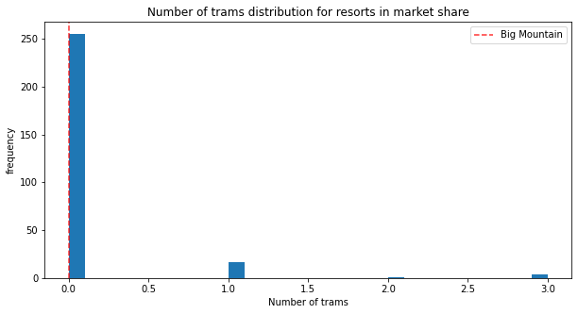
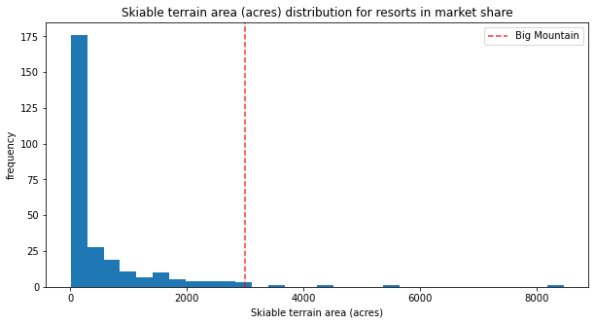
Modeling results and analysis
Big Mountain stance on important features

Slide 8
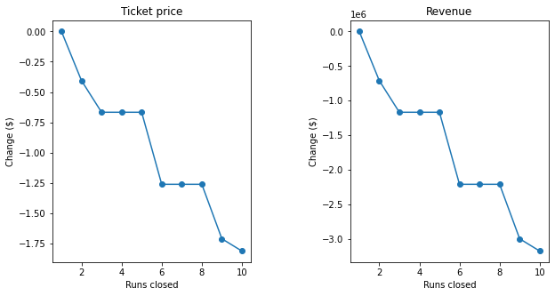
Modeling results and analysis
Ticket price/Revenue reduction with number of runs closed
Ideal runs closed would be 4 or 5, additional runs closed would result in sharp decline in revenues.

Slide 9
Summary and conclusion
Having operating costs would help improve our model and certainly help us to have a more understanding on the price discrepancy.
Big Mountain fares very well at important features so it is not surprising to see a high predicted price.
Since, we used a lot of resorts (276) for our model way more than what learning_curve suggested (40-50), so model can be assumed to be somewhat robust of wrong prices. This would lead us to believe that Big Mountain is underpricing for the facilities it has.
Create a dashboard that would help business leaders see the impact of feature changes on the revenue and make appropriate business decisions.

